Slide 1
ELK

Slide 2
What is ELK?
With use of microservices, we have been able to overcome many legacy problems and it allow us to create stable distributed applications with desired control on the code, team size, maintenance, release cycle, cloud ennoblement etc. But it has also introduced few challenges in other areas e.g. distributed log management and ability to view logs of full transaction distributed among many services and distributed debugging in general.
ELK Tools relieve us from this problem

Slide 3
What is ELK?
Actually the challenge is that microservices are isolated among themselves and they does not share common database and log files. As the number of microservice increases and we enable cloud deployment with automated continuous integration tools, it is very much necessary to have some provision of debugging the components when we have any problem.
set of tools are Elastic Search, Logstash and Kibana – together referred as ELK stack. They are used for searching, analyzing, and visualizing log data in a real time.

Slide 4
ELK Stack
Elasticsearch is a distributed, JSON-based search and analytics engine designed for horizontal scalability, maximum reliability, and easy management.
Logstash is a dynamic data collection pipeline with an extensible plugin ecosystem and strong Elasticsearch synergy.
Kibana gives the visualization of data through a UI.

Slide 5
ELK Stack
Elasticsearch is a distributed, JSON-based search and analytics engine designed for horizontal scalability, maximum reliability, and easy management.
Logstash is a dynamic data collection pipeline with an extensible plugin ecosystem and strong Elasticsearch synergy.
Kibana gives the visualization of data through a UI.

Slide 6
ELK Stack Architecture
Logstash processes the application log files based on the filter criteria we set and sends those logs to Elasticsearch. Through Kibana, we view and analyze those logs when required.

Slide 7
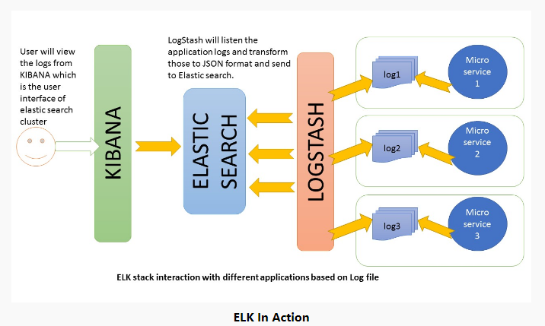
ELK Stack

Slide 8
ELK Stack Architecture
Logstash processes the application log files based on the filter criteria we set and sends those logs to Elasticsearch.
Through Kibana, we view and analyze those logs when required.

Slide 9
ELK Configuration
Follow below steps to configure ELK Stack
ELK Configuration
All these three tools are based on JVM and before start installing them, please verify that JDK has been properly configured. Check that standard JDK 1.8 installation, JAVA_HOME and PATH set up is already done.
Elasticsearch
Download latest version of Elasticsearch Tool and unzip it any folder.
Run bin\elasticsearch.bat from command prompt.
By default, it would start at http://localhost:9200
Kibana
Download the latest distribution and unzip into any folder.
Open config/kibana.yml in an editor and set elasticsearch.url to point at your Elasticsearch instance. In our case as we will use the local instance just uncomment elasticsearch.url: "http://localhost:9200"
Run bin\kibana.bat from command prompt.
Once started successfully, Kibana will start on default port 5601 and Kibana UI will be available at http://localhost:5601

Slide 10
ELK Configuration
Logstash
Download the latest distribution and unzip into any folder.
Create one file logstash.conf as per https://www.elastic.co/guide/en/logstash/current/configuration.html.
We will again come to this point during actual demo time for exact configuration.
Now run bin/logstash -f logstash.conf to start logstash
ELK stack is now up and running. Now we need to create few microservices and point logstash to the API log path.

Slide 11
Procedure
Now take any Project which generates some logs onto a file
Use appropriate configurations for Logstash, restart Logstash
The logs file path is specified in above Logstash conf file
Now open Kibana Dashboard from http://localhost:5601/app/kibana

Slide 12
Kibana Configurations to view log info
Before viewing the logs in Kibana, we need to configure the Index Patterns. We can configure logstash-* as default configuration. We can always change this index pattern in logstash side and configure in Kibana. For simplicity, we will work with default configuration.
The index pattern management page will look like below. With this configuration we are pointing Kibana to Elasticsearch index(s) of your choice. Logstash creates indices with the name pattern of logstash-YYYY.MM.DD We can do all those configuration in Kibana console http://localhost:5601/app/kibana and going to Management link in left panel.

